Slide 1
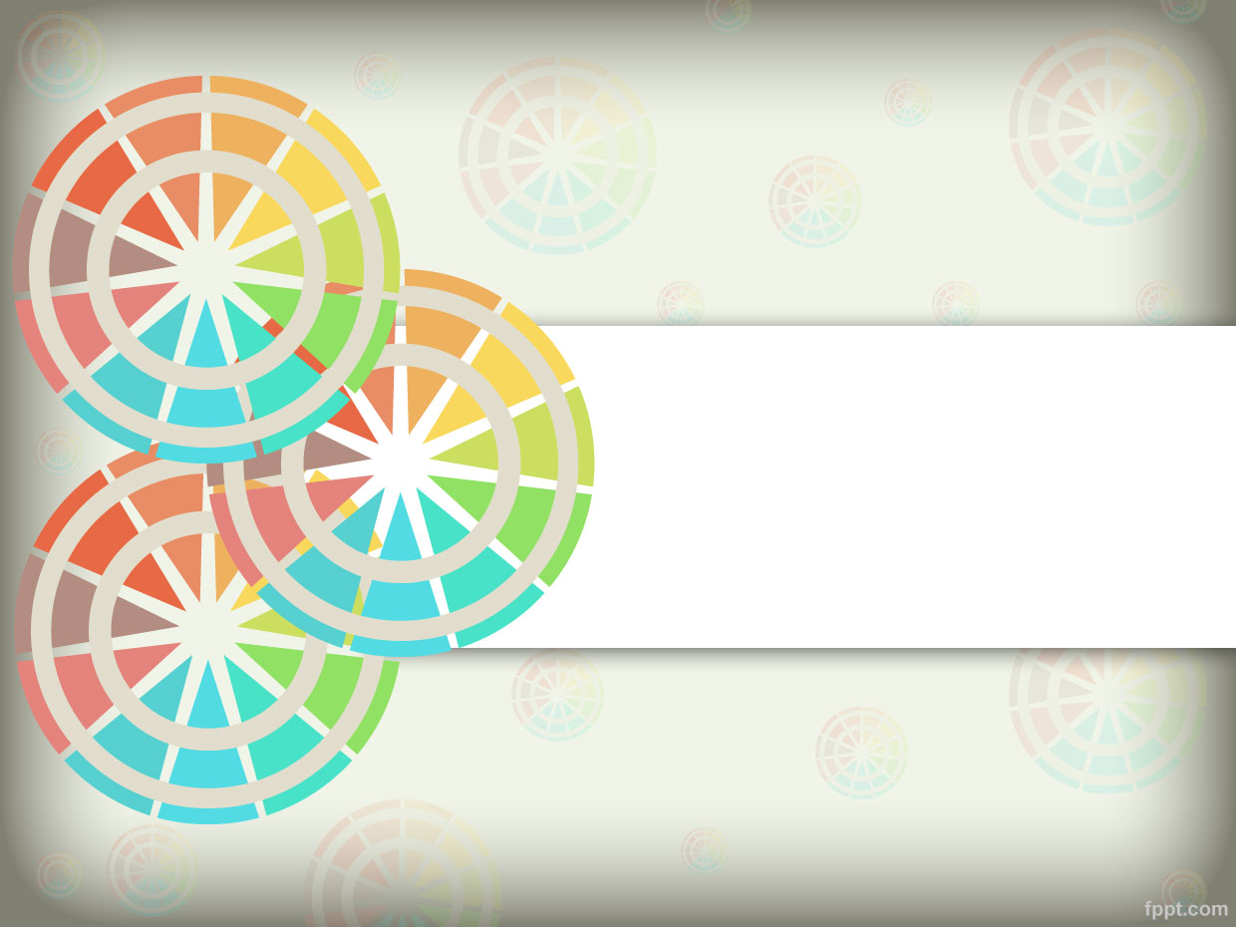
Mongo Geolocation
https://www.youtube.com/watch?v=MMURwR7I2ak

Slide 2
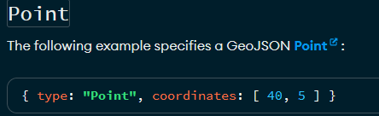
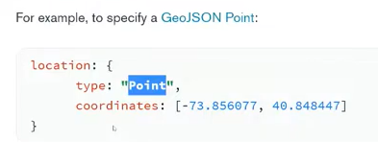
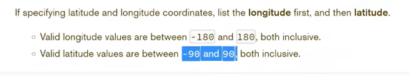
GeoJSON Objects

Slide 3
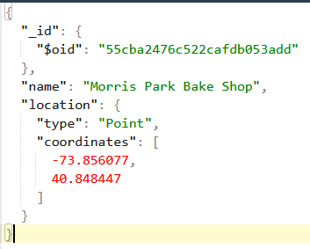
Geojson
{
"_id": {
"$oid": "55cba2476c522cafdb053add"
},
"name": "Morris Park Bake Shop",
"location": {
"type": "Point",
"coordinates": [
-73.856077,
40.848447
]
}
}

Slide 4
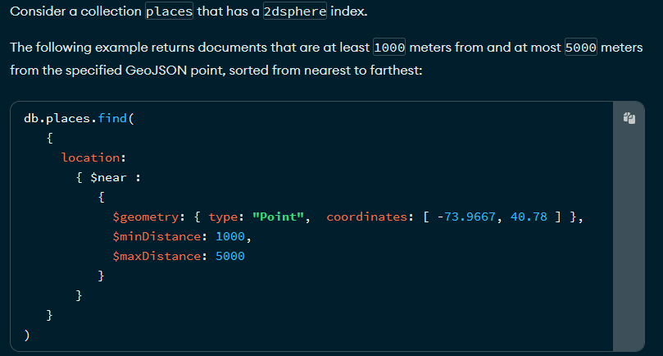
$near

Slide 5
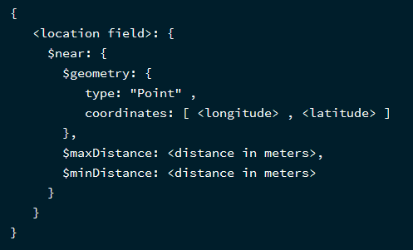
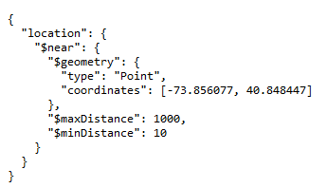
Search nearby location --- $near
{
"location": {
"$near": {
"$geometry": {
"type": "Point",
"coordinates": [-73.856077, 40.848447]
},
"$maxDistance": 1000,
"$minDistance": 10
}
}
}

Slide 6
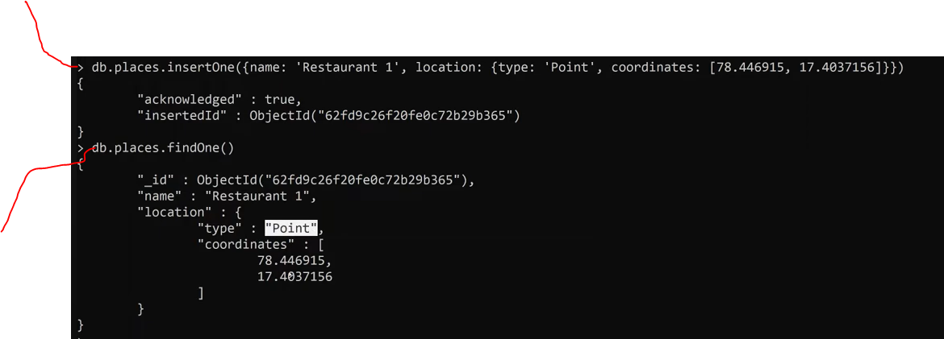
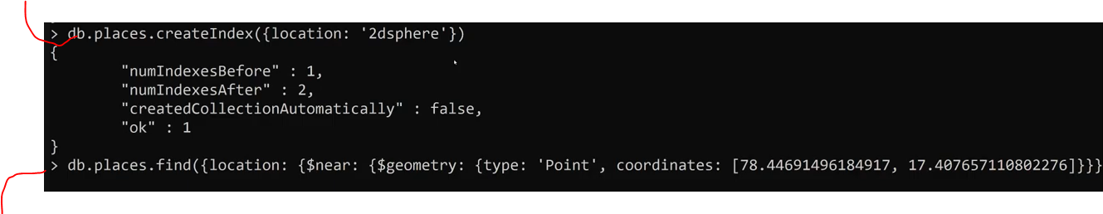
mongo add geoJson data find

Slide 7
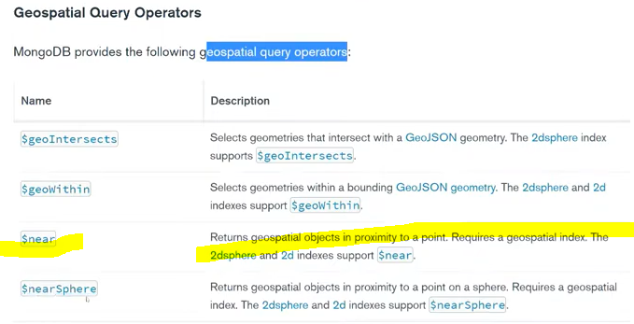
GeoSpatial Query

Slide 8
mongo

Slide 9
mongo

